Slide 1
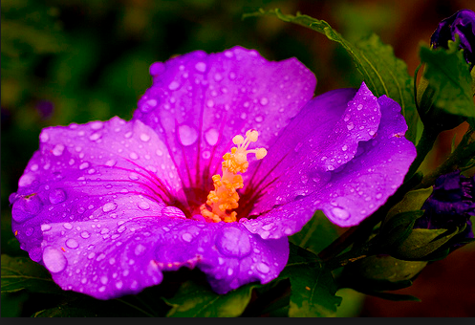
Purple Hibiscus
Many species are grown for their showy flowers or used as landscape shrubs, and are used to attract butterflies, bees, and hummingbirds. Hibiscus is a very hardy, versatile plant and in tropical conditions it can enhance the beauty of any garden.

Slide 2
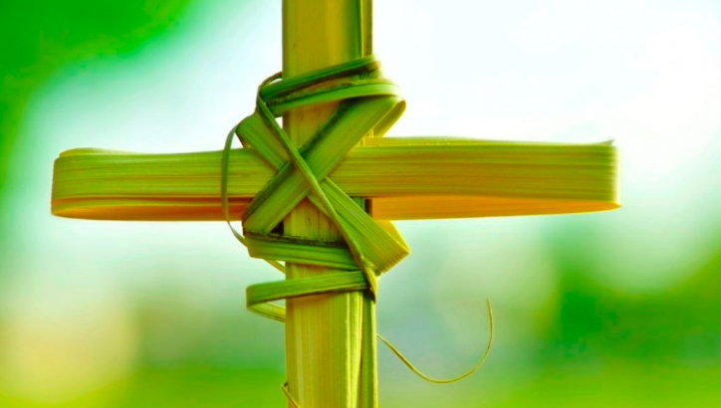
Palm Sunday
The Sunday before Easter, when the triumphal entry of Jesus into Jerusalem is celebrated in many Christian churches by processions in which palm fronds are carried.

Slide 3
Things started to fall apart at home
Things Fall Apart is acclaimed as the finest novel written about life in Nigeria at the end of the nineteenth century. Published in 1958, it is unquestionably the world’s most widely read African novel, having sold more than eight million copies in English and been translated into fifty languages. But it offers far more than access to pre-colonial Nigeria and the cataclysmic changes brought about by the British.

Slide 4
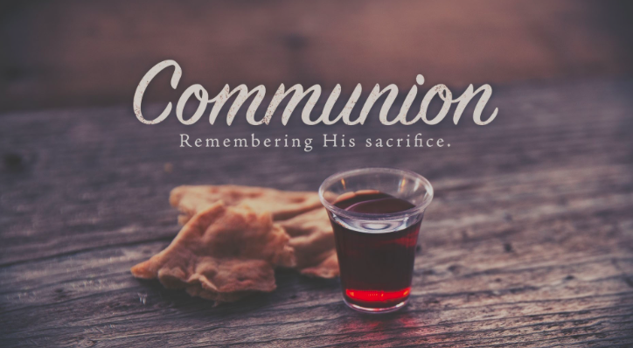
when my brother, Jaja, did not go to communion

Slide 5
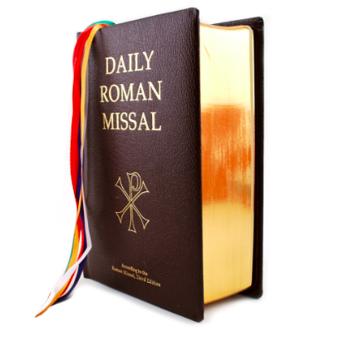
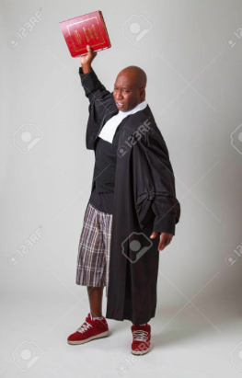
And Papa flung his heavy missal across the room

Slide 6
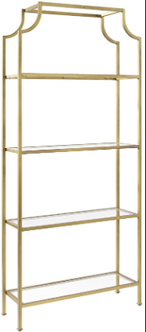
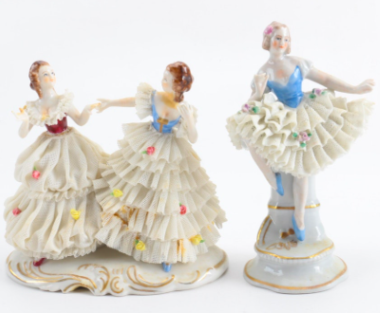
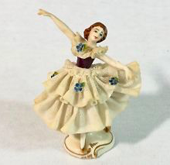
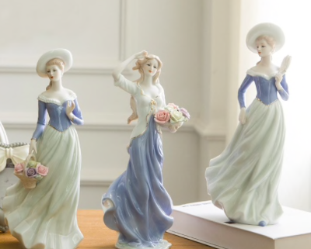
And broke the figurines on the etagere.

Slide 7
We had just returned from church.

Slide 8
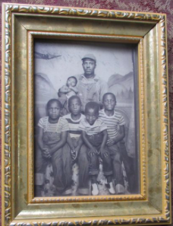
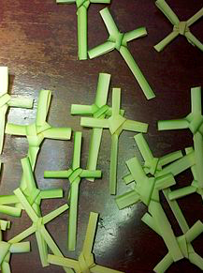
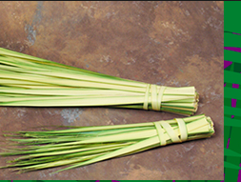
Mama placed the fresh palm fronds, which were wet with holy water, on the dining room table and went upstairs to change.
Later, she would knot the palm fronds into sagging cross shapes and hang them on the wall beside our gold-framed family photo.

Slide 9
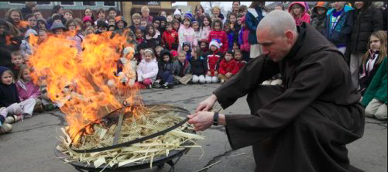
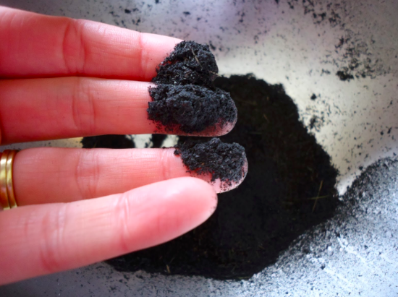
Ash Wednesday marks the beginning of the lent in the Christian calendar. The day also marked the beginning of forty days of fasting and abstinence by the faithful. It is a special time of fasting, repentance and prayer for the Christians. Ash Wednesday emphasized on two specific themes namely man’s sinfulness before God and human mortality.
They would stay there until next Ash Wednesday, when we would take the fronds to church, to have them burned for ash.

Slide 10
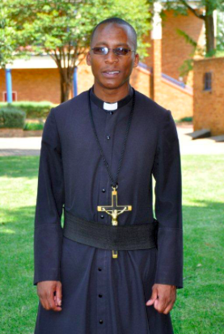
An oblate is a Christian who seeks God through a formal relationship. Oblates are men or women, lay or ordained, married or single, who seek to integrate the spirit of Saint Benedict in their daily lives.
Papa, wearing a long, gray robe like the rest of the oblates, helped distribute ash each year.

Slide 11
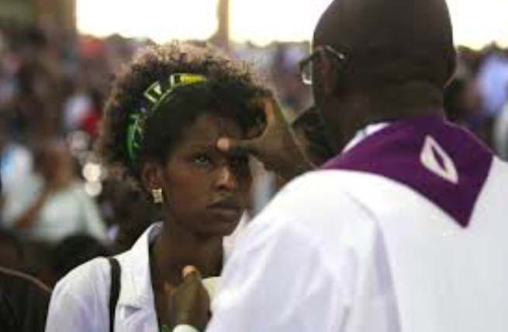
His line moved the slowest because he pressed hard on each forehead to make a perfect cross with his ash-colored thumb and slowly, meaningfully enunciated every word of…

Slide 12
Dust and unto dust you shall return.
Genesis 3:19

Slide 13
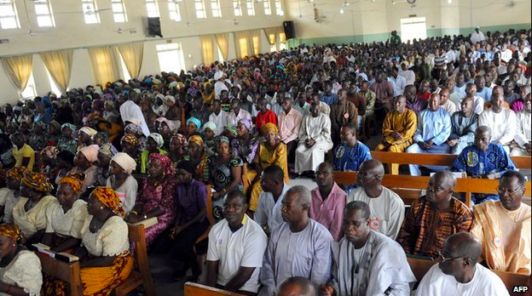
Papa always sat in the front pew for Mass, at the end beside the middle aisle, with Mama, Jaja, and me sitting next to him.

Slide 14
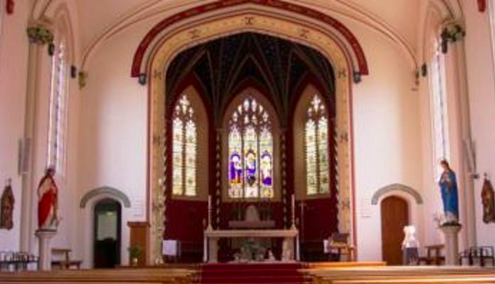
He was the first to receive communion. Most people did not kneel to receive communion at the marble altar, with the blond life-size Virgin Mary mounted nearby, but Papa did.

Slide 15
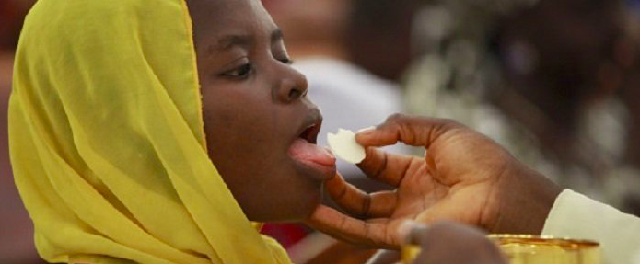
He would hold his eyes shut so hard that his face tightened into a grimace, and then he would stick his tongue out as far as it could go.

Slide 16
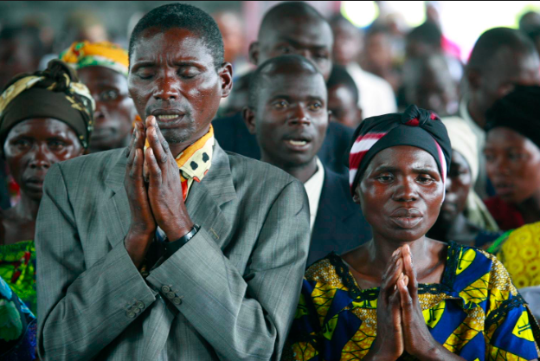
Afterward, he sat back on his seat and watched the rest of the congregation troop to the altar, palms pressed together and extended, like a saucer held sideways, just as Father Benedict had taught them to do.

Slide 17
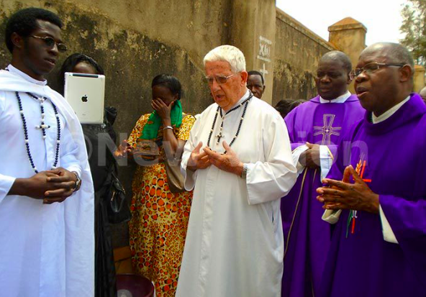
Even though Father Benedict had been at St. Agnes for seven years, people still referred to him as “our new priest.” Perhaps they would not have if he had not been white. He still looked new.

Slide 18
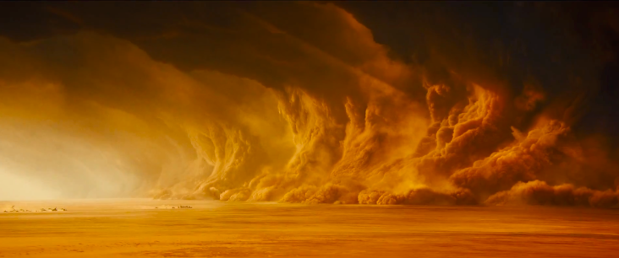
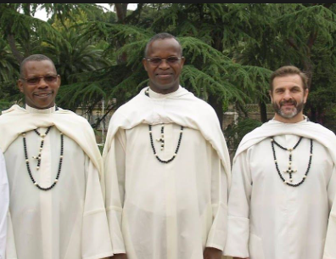
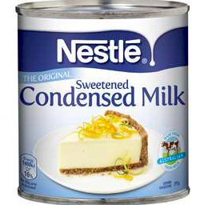
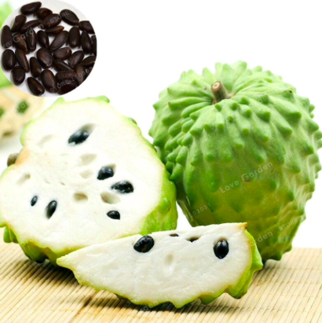
The colors of his face, the colors of condensed milk and cut-open soursop, had not tanned at all in the fierce heat of seven Nigerian harmattans.

Slide 19
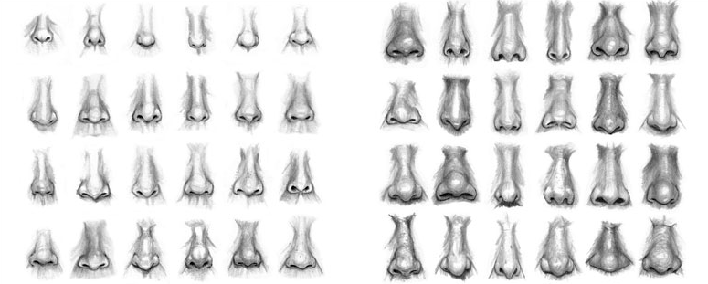
And his British nose was still as pinched and narrow as it always was, the same nose that had me worried that he did not get enough air when he first came to Enugu.

Slide 20
Ekwere m na mmụọ nsọ
Father Benedict had changed things in the parish, such as insisting the the Credo and kyrie be recited only in Latin; Igbo was not acceptable.
Notes:
I believe in the holy spirit

