Slide 1
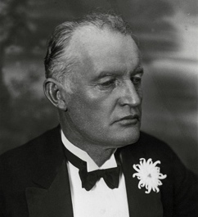
Edvard Munch 1863-1944

Slide 2
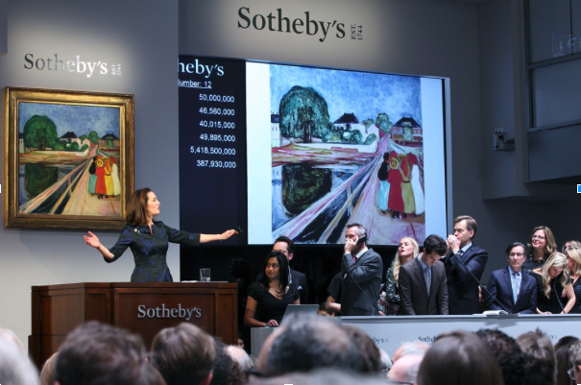

Slide 4
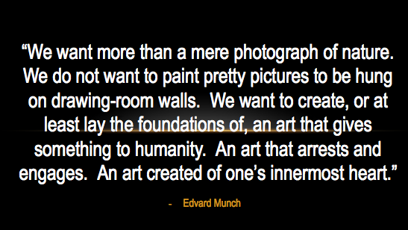

Slide 6
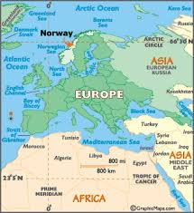
Born in Oslo, Norway in 1863

Slide 8
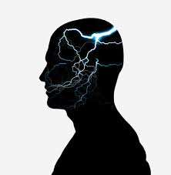
Edvard’s Childhood
Mother died of Tuberculosis
Raised by Mentally Ill Father
4 siblings
Elder sister Sophie died of TB at Age 15
Younger Sister Mentally Ill

Slide 9
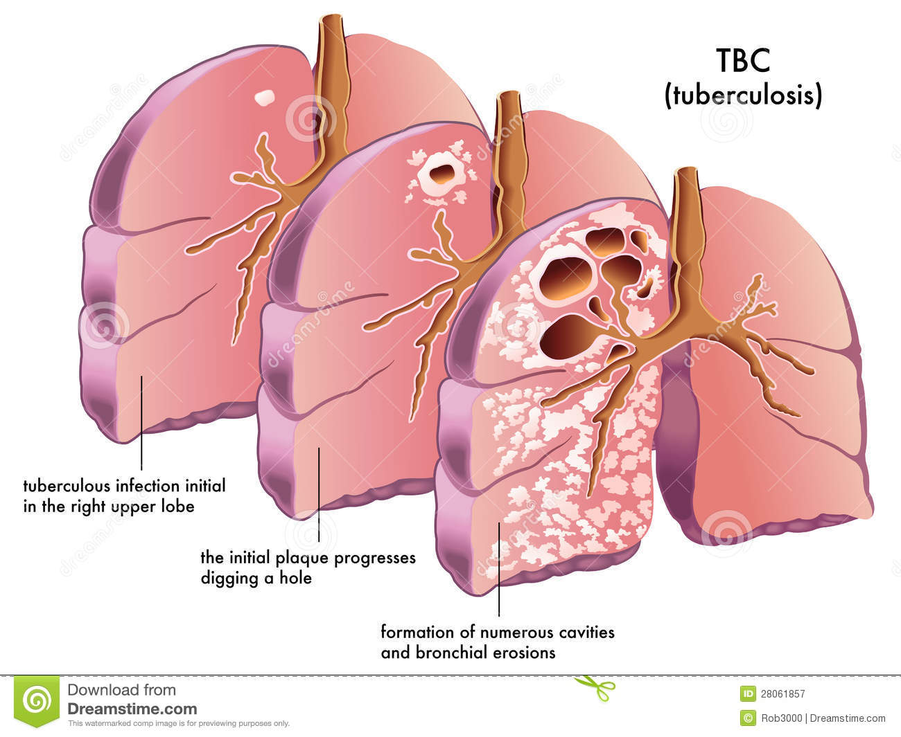
Tuberculosis AKA TB or phthisis or Consumption
Symptoms include persistent cough with phlegm or blood
Common in Refugee Camps
Can cause damage to kidneys, liver, and other organs

Slide 10
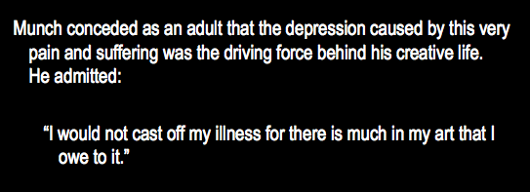
Munch’s Family tragedy led to Creativity

Slide 12
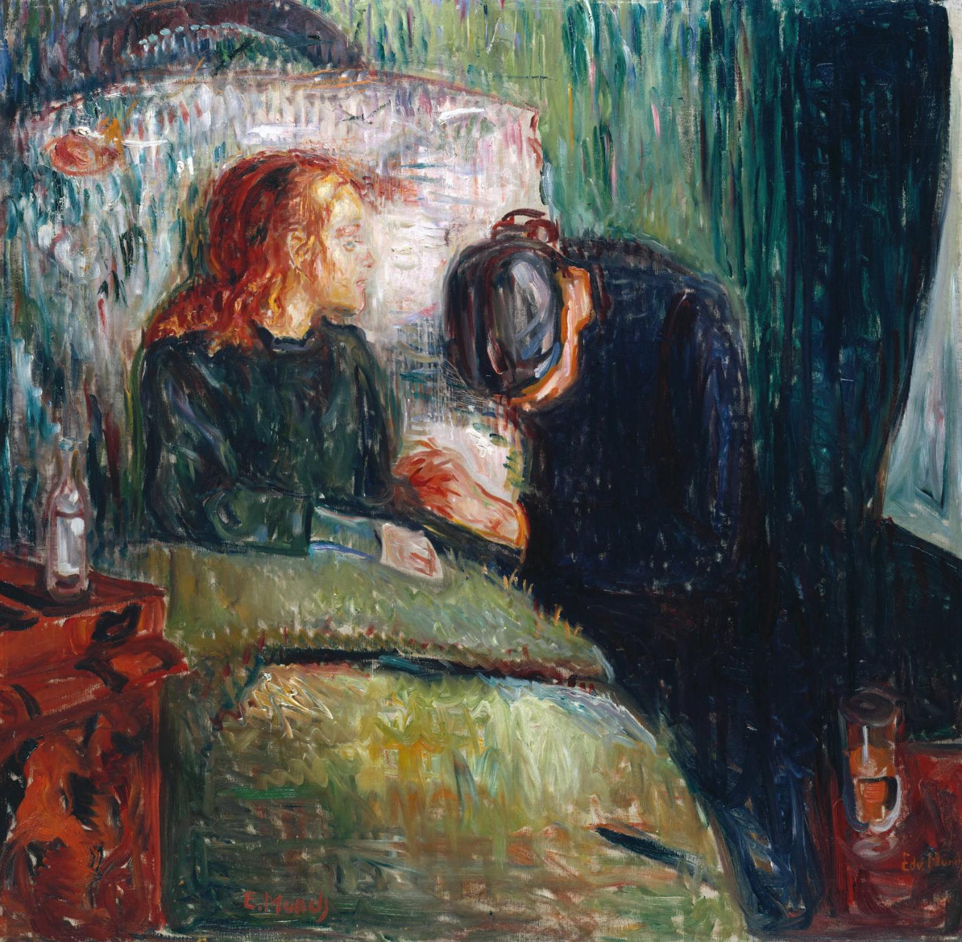
Sick Child (1885)
Notes:
A decade later, the Nazis declared that Munch’s art was ‘degenerate’ and, in November 1938, all his works in German public collections were collected in Berlin for auction. Thomas Olsen bought the painting in 1939 and gave it to the Tate. Norway fell to the Germans in 1940. Looking back, Olsen explained that his gift was stimulated by ‘my knowledge, from talks with Munch, that he felt the need of recognition in Western Europe, especially so after the advent of Hitler.’ http://www.tate.org.uk/art/artworks/munch-the-sick-child-n05035

Slide 13
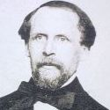
Christian Munch
Deeply Religious
Military Doctor
Mentally Ill
Raised Children to Fear Hell

Slide 14
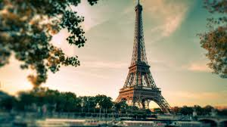
Edvard’s Artistic INfluences
Visit to Paris in 1885
Influenced by Impressionists and Post-Impressionists

Slide 15
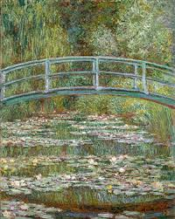
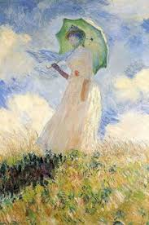
Impressionism
Claude Monet
Notes:
They painted contemporary landscapes and scenes of modern life, especially of bourgeois leisure and recreation, instead of drawing on past art or historical and mythological narrative for their inspiration. Interested in capturing transitory moments, the Impressionists paid attention to the fleeting effect of light, atmosphere and movement. http://www.oxfordartonline.com/public/page/themes/impressionismandpostimpressionism

Slide 16
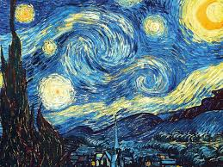
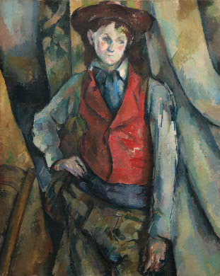
Post-Impressionism?
Cezanne, Van Gogh
Notes:
The Post-Impressionists rejected Impressionism’s concern with the spontaneous and naturalistic rendering of light and color. Instead they favored an emphasis on more symbolic content, formal order and structure. Similar to the Impressionists, however, they stressed the artificiality of the picture. http://www.oxfordartonline.com/public/page/themes/impressionismandpostimpressionism

Slide 17
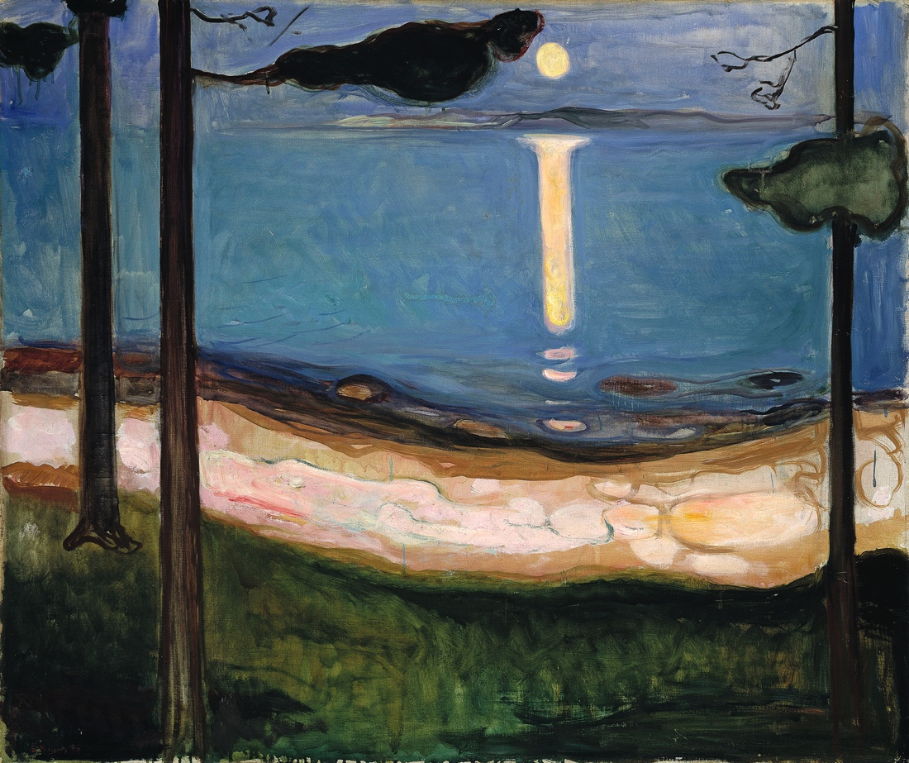
Munch’s “Moonlight” (1895)

Slide 18
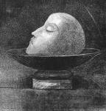
What Style was Munch?
Expressionism:
Vivid Colors / Abstracted Forms
Psychologically Intense Works
Symbolism: Internal view, not what the eye could see
“Art should reflect an emotion or idea”
Not the natural world in a realist or scientific way
Notes:
Redon 1877

Slide 19
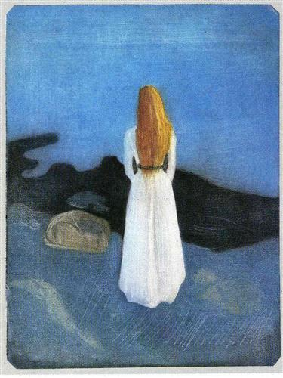
Munch’s Themes and Ideas
Life and Death
Love and Terror
Loneliness
Nature is not only all that is visible to the eye...
it also includes the inner pictures of the soul.”
- Edvard Munch
Notes:
Young Woman on the Shore (1896)

Slide 20
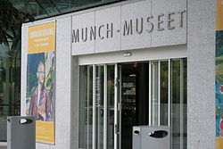
Munch’s Death and Legacy
Died in 1944
Munch Museum of Art established in Norway

Slide 21
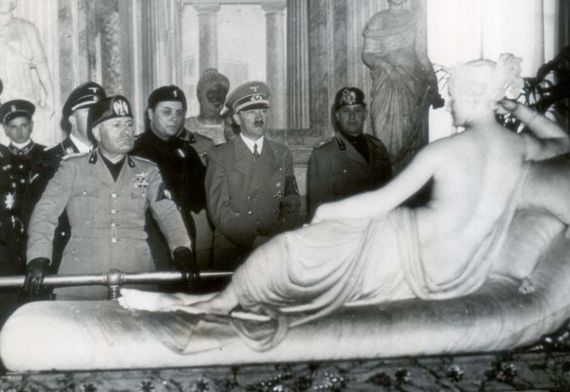
Classical Only Munch’s art Seized or Hidden
Germans captured Norway (1940)
Many paintings seized by Nazis
Nazis called Munch’s work “degenerate art”
“The Scream” and “The Sick Child” hidden from Nazis

Slide 22
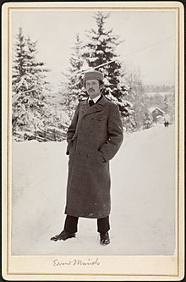
His Work

Slide 24
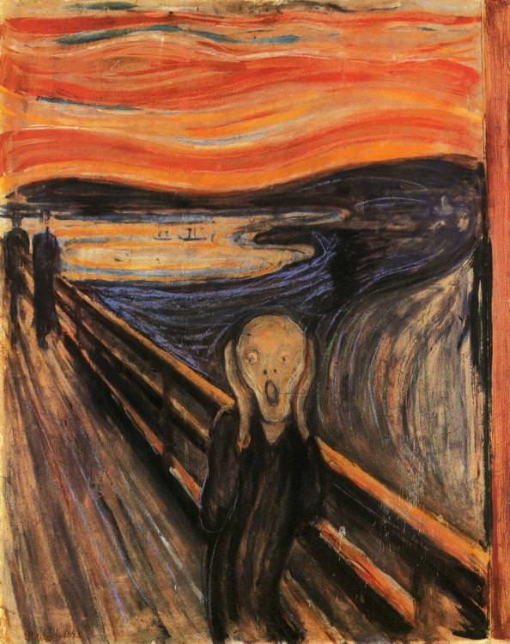
The Scream (1893)

Slide 25
The Story Behind “the Scream”
"I was walking down the road with two friends when the sun set; suddenly, the sky turned as red as blood. I stopped and leaned against the fence ... shivering with fear. Then I heard the enormous, infinite scream of nature."
Notes:
Sister in Mental Hospital in Oslo

Slide 27
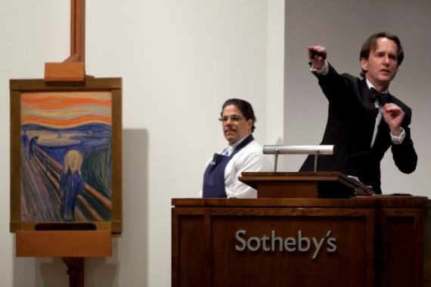
The Scream: Interesting Facts
Several Art Thefts
Sold for $120 Million in 2012

Slide 28
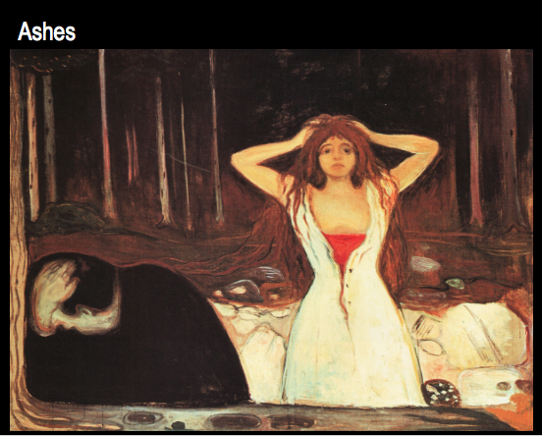

Slide 30
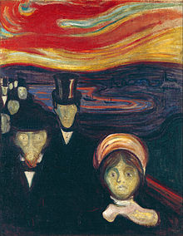
Anxiety (1894)

Slide 31
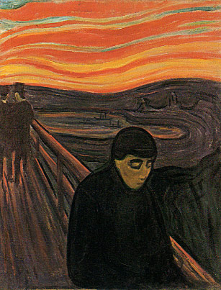
Despair (1893-4)

Slide 32
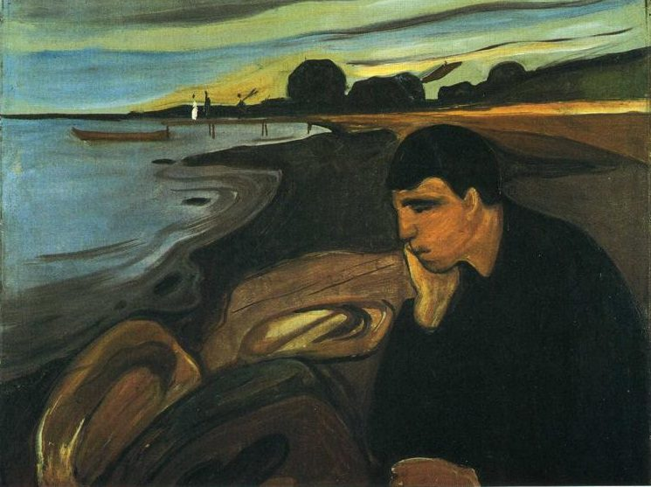
Melancholy (1894)

Slide 33
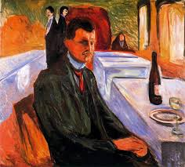
Munch’s later years
Inner Demons
Drank Excessively
Checked into Sanitarium
"The rages were coming more and more often now. The drink was meant to calm them, especially in the morning but as the day wore on I became nervy, angry.”
Notes:
Self portrait with bottle of wine (1906)

Slide 34
“My fear of life is necessary to me, as is my illness. Without anxiety and illness, I am a ship without a rudder. My art is grounded in reflections over being different from others. My sufferings are part of my self and my art. They are indistinguishable from me, and their destruction would destroy my art. I want to keep those sufferings.”
―Edvard Munch

