Slide 1
Inside Jobs

Slide 2
If you Guessed El Chapo you're Right.

Slide 3
Wasn’t He Arrested?
El Chapo was arrested most recently on February 22, 2014 and escaped July 11, 2015.
For those of you who do not know, he escaped through a mile long tunnel dug up to the shower in his cell.

Slide 4
Let’s do Some Quick Math
He was in containment for 504 days.
How many feet in a mile?
5,280
5,280/504= ?
~10.5 feet of digging per day.
How did this happen?

Slide 5
Do we know who did it?
Can you guess how many were involved?
Mexico's government announced the capture of six people believed responsible for the July prison break.
Guzman's brother in law was the head of Guzman’s escape.
Between these individuals Guzman was able to complete his elaborate escape.

Slide 6
These seem like Obvious Arrests
These do seem like some basic arrests, but authorities are being fed lots of false information.
One federal official stated there were two pilots, one was just a ruse to throw authorities off course.
Both pilots have now been arrested.

Slide 7
Where were “Mexico’s Finest”?
How could so many security guards and officers let El Chapo escape?
Because they were helping him escape!
*Pause for Gasp from Audience*
How many officials and guards have been arrested?
There are 23 officials that have been arrested. They all had something to do with the case.

Slide 8
This Explains a Little More
How can so many guards and officers be at fault?
Government acknowledged that Guzmán was allowed to remain in the same cell for the 504-day duration of his incarceration before he ran away.
Normal Prison Law states he should be rotated cells every month.
Underground prison alarms were turned off so no one was aware of any digging occurring.

Slide 9
And even a Little More
The original camera in Guzman's cell had no blind spots, it was changed sometime in his incarceration and had two blind spots.
Someone deactivated his ankle bracelet the day of the escape.

Slide 10
Not all Hope is Lost
Guzman has been spotted and pursued.
He was spotted on October 9 near the town of Cosala, right next to the mountains.
When pursuit was underway Guzman fell off a cliff and broke his leg and injured his face.
He was able to escape with the help of body guards, but with the limited mobility authorities are hopeful.

Slide 11
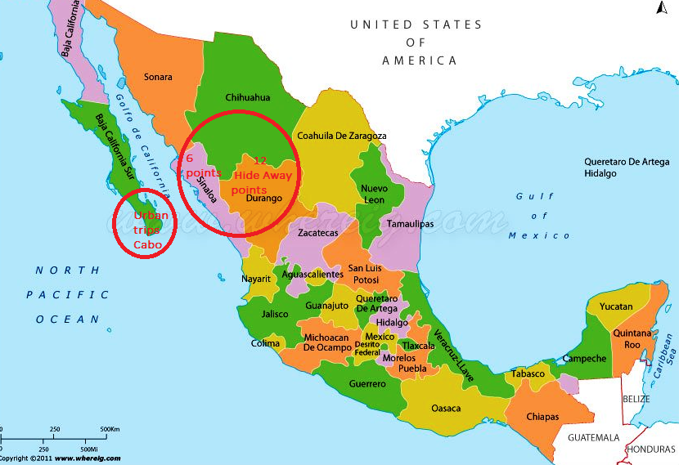
Where are we Looking?
The search for Guzman has been narrowed to Sinaloa and the neighboring Durango State.
This happens to be Mexico’s drug-producing “Golden Triangle Region”
Authorities are asking anyone for help and offering $5,000,000 for even good advice on his whereabouts.

Slide 12
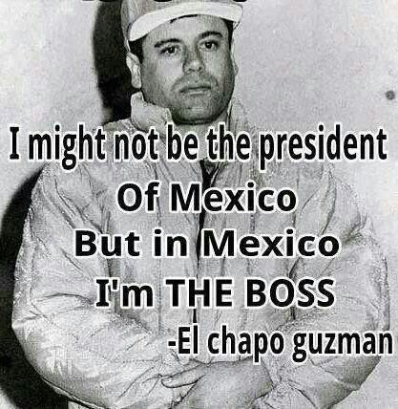
So why cant we find him?
Sinaloa happens to be Guzman’s hometown; authorities think he is able to stay mobile by staying with family friends, relatives, etc.

Slide 13
Sources
http://abcnews.go.com/International/wireStory/mexico-arrests-drug-lord-el-chapo-guzmans-jailbreak-34639697
http://www.nytimes.com/aponline/2015/10/21/world/americas/ap-lt-mexico-drug-lord-escapes.html?ref=world
http://www.cnn.com/videos/world/2015/07/12/el-chapo-profile-joaquin-guzman-dnt-ganim.cnn
http://www.forbes.com/sites/doliaestevez/2015/07/22/the-five-facts-that-suggest-drug-kingpin-el-chapo-guzman-was-let-out-of-prison/2/

